Slide 1
UNIT II
Structure and functions of :
carbohydrates
lipids
proteins
enzymes
hormones
DNA
RNA
The human genome project
Genomics
Sequence databases
BLAST tool

Slide 2
Chemistry of life: chemical bonds

Slide 3
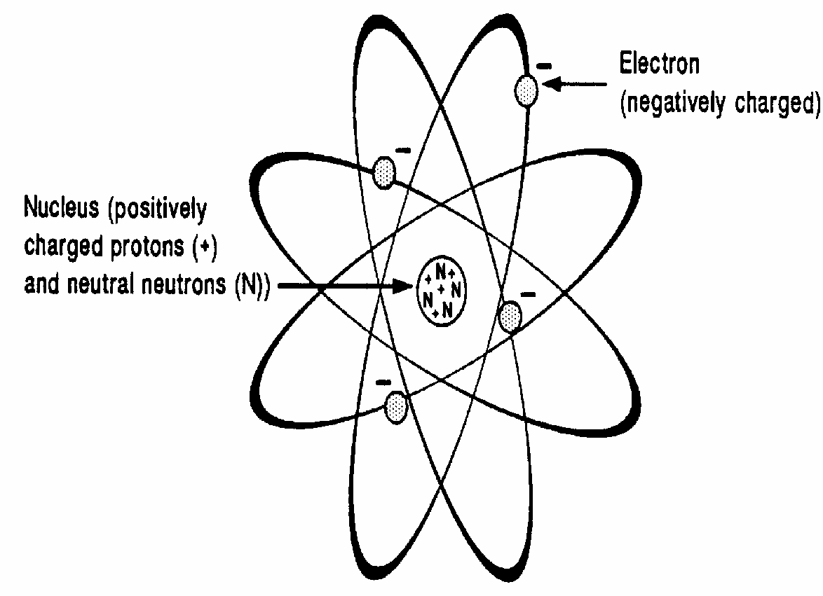
Chemistry of Life
All matter is built up of simple units called atoms.
Although the word atom means something that cannot be cut (a = ‘‘without,’’ tom = ‘‘cut’’), these elementary particles are actually made up of many smaller parts, which are themselves further divisible.
Elements are substances that consist of the same kinds of atoms.
Compounds consist of units called molecules, which are intimate associations of atoms (in the case of compounds, different atoms) joined in precise arrangements.

Slide 4
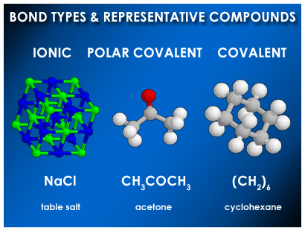
Atoms interact with one another to form chemical communities. The tightly knit atoms making up the communal molecules are held together by chemical bonding.
One way of achieving this more stable state is for an atom with very few electrons in its outer shell to donate them to an atom with an outer shell that is almost complete.
The atom that donates the electrons will then have more protons than electrons and assume a positive charge; it is called a cation. The atom receiving the electrons assumes a negative charge and is called an anion.
These two oppositely charged ions are electrostatically attracted to each other and are said to have an ionic, or polar, bond.

Slide 5
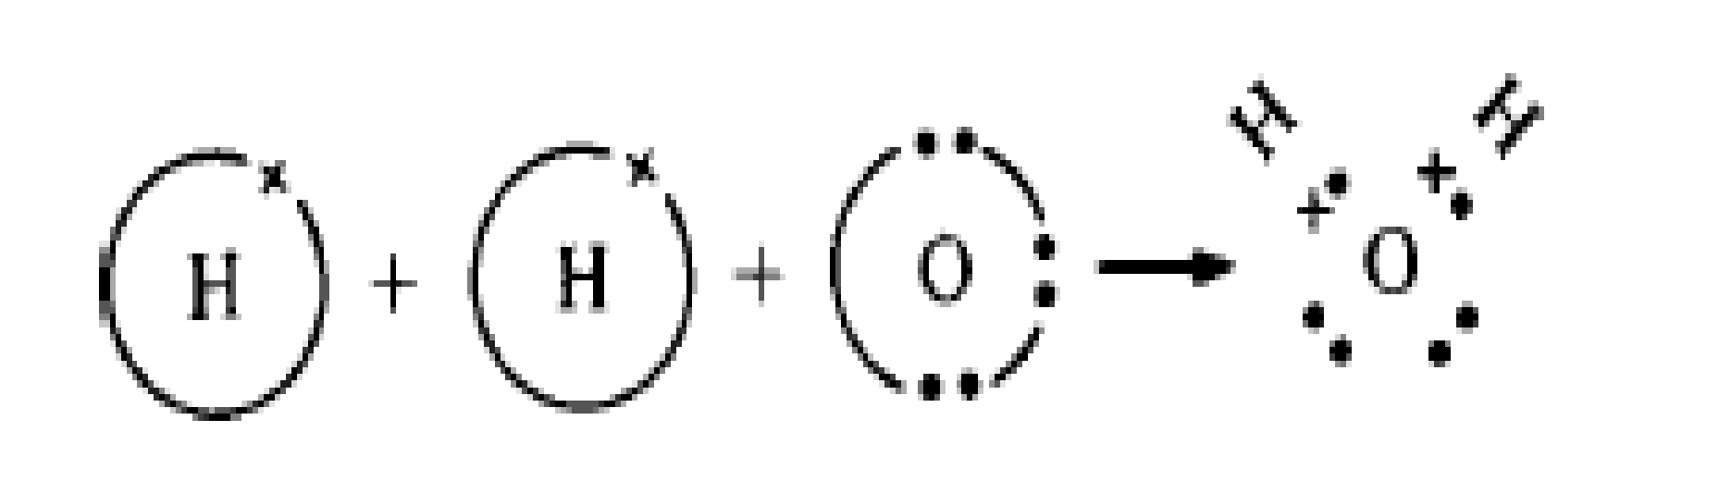
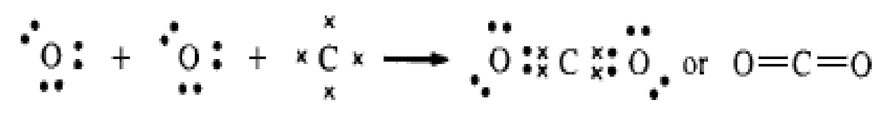
A second way in which atoms may join with one another to bring about a filling of their outermost shells is by sharing a pair of electrons.
The two bonding atoms provide one electron each in creating the shared pair. This pair of electrons forms a covalent bond that holds the two atoms together. It is represented by a solid line in the formula of a compound.
In many molecules, covalent bonding may occur not just singly (sharing a single pair of electrons), but may involve the formation of double or triple bonds in which two and even three pairs of electrons are shared.
These double and triple bonds tend to fix the position of the participating atoms in a rigid manner.

Slide 6
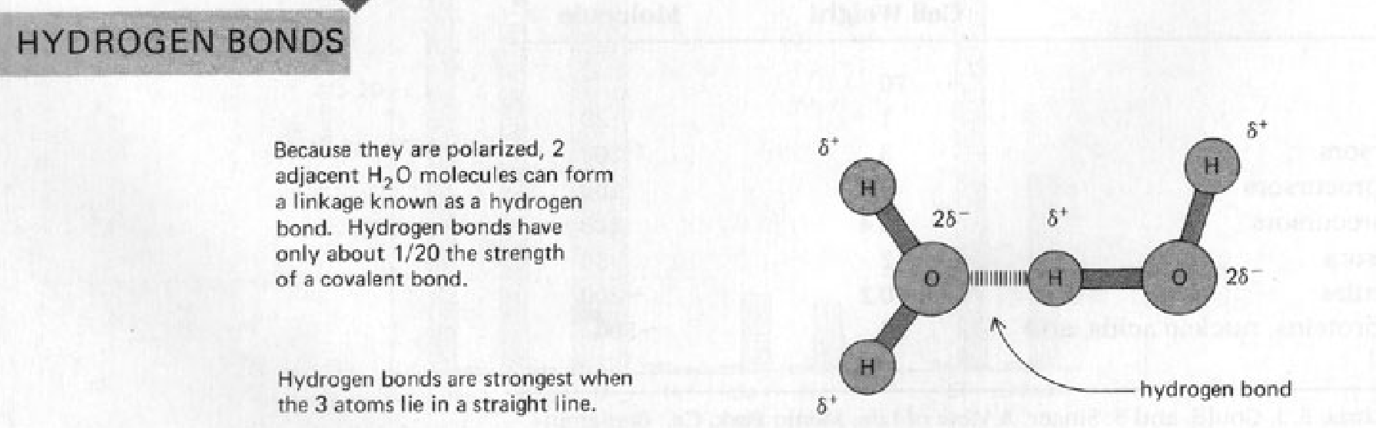
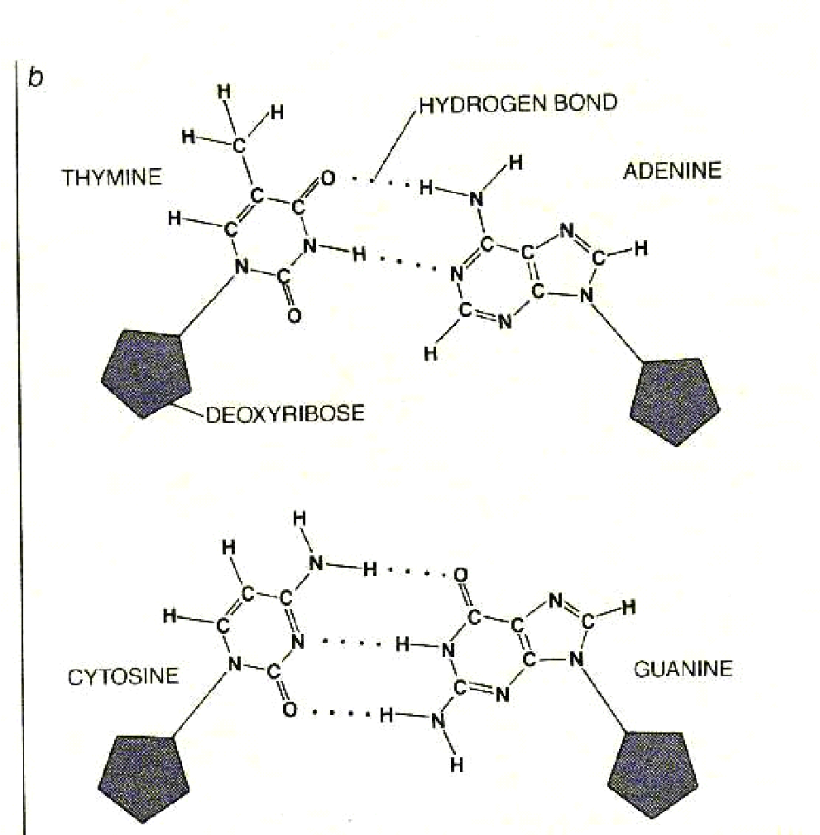
Non-covalent bonds (ionic, hydrogen) are much weaker than covalent bonds (electron sharing) and so protein shape can be disrupted especially by temperature, pH , ions (salt).
It involves more dispersed variations of electromagnetic interactions.
Critical in maintaining the three-dimensional structure of large molecules, such as proteins and nucleic acids
There are four commonly mentioned types of non-covalent interactions: hydrogen bonds, ionic bonds, van der Waals forces, and hydrophobic interactions.
The noncovalent interactions hold together the two strands DNA in the double helix, stabilize secondary and tertiary structures of proteins, and enable enzyme-substrate binding and antibody-antigen association.

Slide 7
Biochemistry and Human biology

Slide 8
Biochemistry: Where Chemistry & Biology Meet
Living things require millions of chemical reactions just to survive.
Metabolism = all the chemical reactions occurring in the body.
Organic molecules:
usually associated with living things.
always contain CARBON.
are “large” molecules, with many atoms
always have covalent bonds (share electrons)

Slide 9
Biochemistry and Human Biology
Biochemistry: Science concerned with the chemical constituents of living cells and with the reaction and process that they undergo.
Complete understanding at the molecular level of all the chemical processes associated with living cells
An appreciation of the biochemistry of less complex form of life is often direct relevance to human biochemistry
Reciprocal relationship between biochemistry and medicine has stimulated mutual advance
Biochemistry studies have illuminated many aspects of health & disease

Slide 10
Biochemistry
Nucleic acid
Protein
Lipid
Carbohydrates
Sickle cell anemia
Atherosclerosis
Diabetes mellitus
Genetic disease
Medicine

Slide 11
S. No. | Disease | Causes
1 | Scurvy rickets | deficiencies of vitamins C and D respectively
2 | Atherosclerosis | genetic, dietary, environmental factors
3 | Cystic fibrosis | mutation in the gene coding the CFTR protein (Cystic fibrosis transmembrane conductance regulator, a protein involved in the transport of chloride ions across cell membranes)
4 | Cholera | exotoxin of vibrio cholera
5 | Diabetes mellitus type I | genetic and environmental factors resulting in deficiency of insulin
6 | Phenylketonuria | mainly mutation in the gene coding phenylalanine hydroxylase

Slide 12
Carbon-based Molecules
Although a cell is mostly water, the rest of the cell consists mostly of carbon-based molecules
Organic chemistry is the study of carbon compounds
Notes:
12
12

Slide 13
Carbon is a Versatile Atom
It has four electrons in an outer shell that holds eight
Carbon can share its electrons with other atoms to form up to four covalent bonds
Notes:
13
13

Slide 14
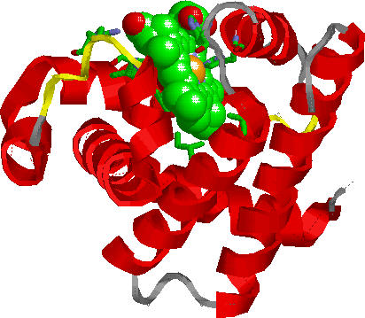
Giant Molecules - Polymers
Large molecules are called polymers
Polymers are built from smaller molecules called monomers
Biologists call them macromolecules
Macromolecules in Organisms
There are four categories of large molecules in cells:
Carbohydrates
Lipids
Proteins
Nucleic Acids
Notes:
14
14

Slide 15
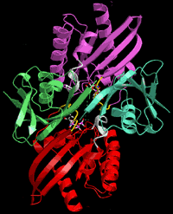
Examples of Polymers
Proteins
Lipids
Carbohydrates
Nucleic Acids
Notes:
15
15

Slide 16

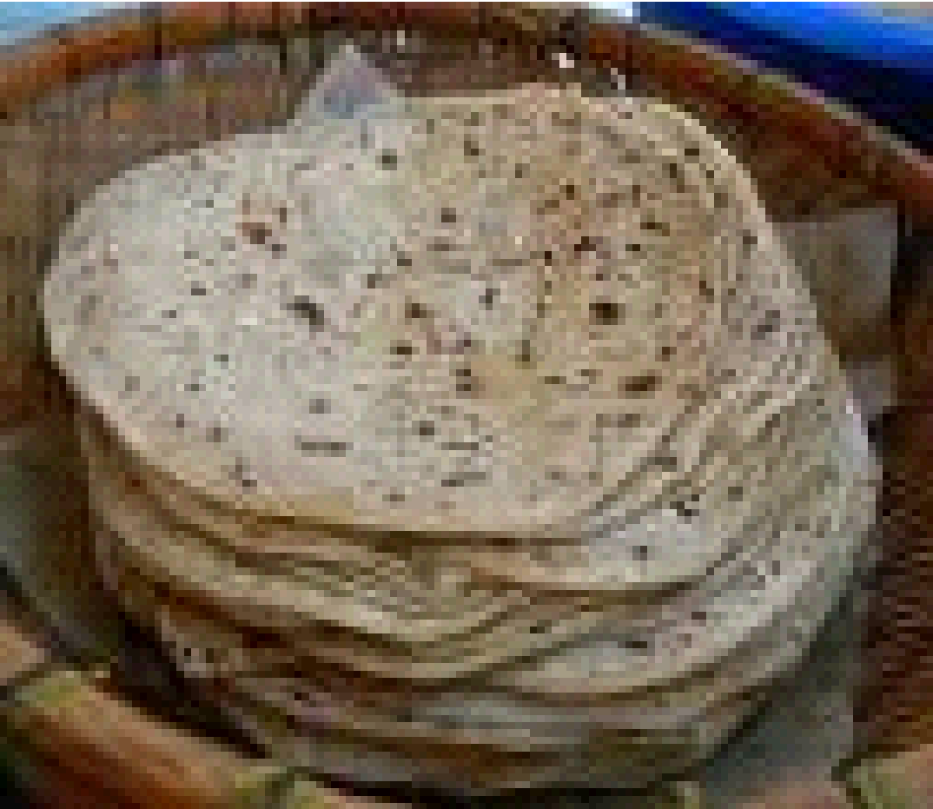
Carbohydrates
Carbohydrates include:
Small sugar molecules in soft drinks
Long starch molecules in rice, wheat, pasta and potatoes
Notes:
16
16

Slide 17
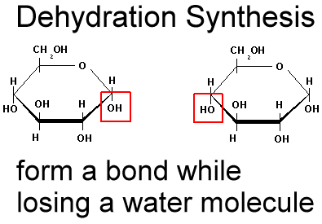
Linking Monomers
Cells link monomers by a process called condensation or dehydration synthesis (removing a molecule of water)
Remove H
H₂O Forms
Remove OH
This process joins two sugar monomers to make a double sugar
Notes:
17
17

Slide 18
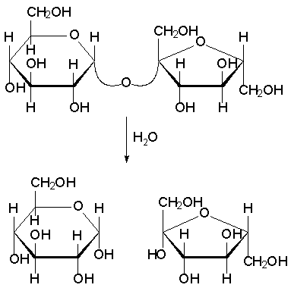
Breaking Down Polymers
Cells break down macromolecules by a process called hydrolysis (adding a molecule of water)
Water added to split a double sugar
Notes:
18
18

Slide 19
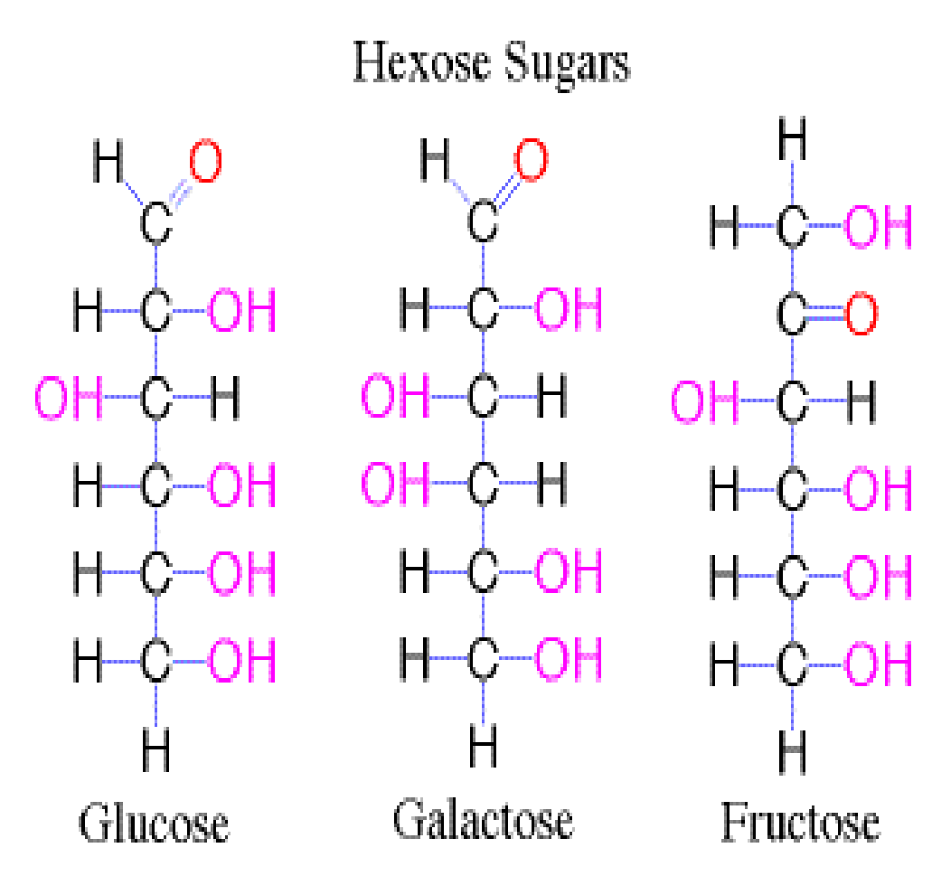
Monosaccharides
Called simple sugars
Include glucose, fructose, & galactose
Have the same chemical, but different structural formulas
C₆H₁₂O₆
Notes:
19
19

Slide 20
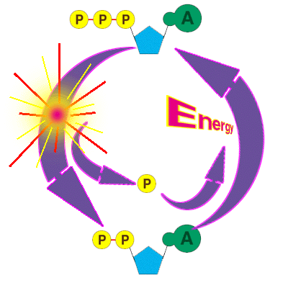
Cellular Fuel
Monosaccharides are the main fuel that cells use for cellular work
ATP
Notes:
20
20

Slide 21
Disaccharides
A disaccharide is a double sugar.
They’re made by joining two monosaccharides
Involves removing a water molecule (condensation)
Bond called a GLYCOSIDIC bond
Notes:
21
21

Slide 22
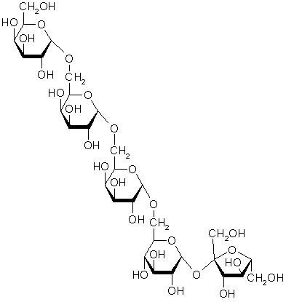
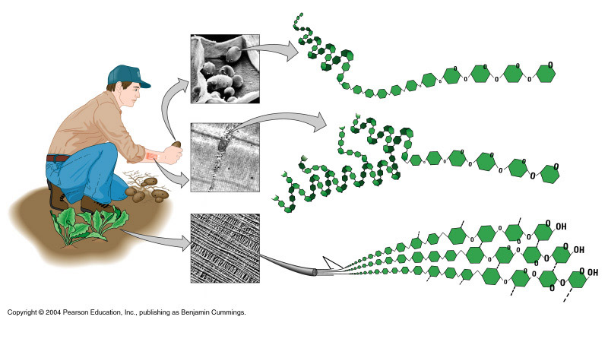
Polysaccharides
Complex carbohydrates
Composed of many sugar monomers linked together
Glucose Monomer
Polymers of monosaccharide chains
Starch
Glycogen
Cellulose
Notes:
22
22

Slide 23
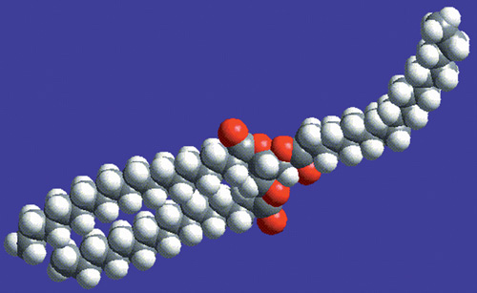
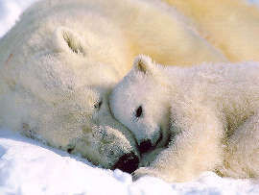
Lipids
Lipids are hydrophobic –”water fearing”
Do NOT mix with water
Includes fats, waxes, steroids, & oils
Fats store energy, help to insulate the body, and cushion and protect organs
FAT MOLECULE
23
Notes:
23
23

Slide 24
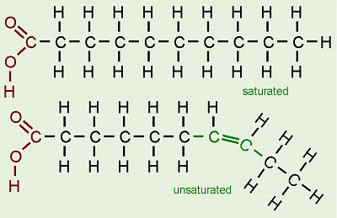
Types of Fatty Acids
Saturated fatty acids have the maximum number of hydrogens bonded to the carbons (all single bonds between carbons)
Unsaturated fatty acids have less than the maximum number of hydrogens bonded to the carbons (a double bond between carbons)
Single Bonds in Carbon chain
Double bond in carbon chain
24
Notes:
24
24

Slide 25
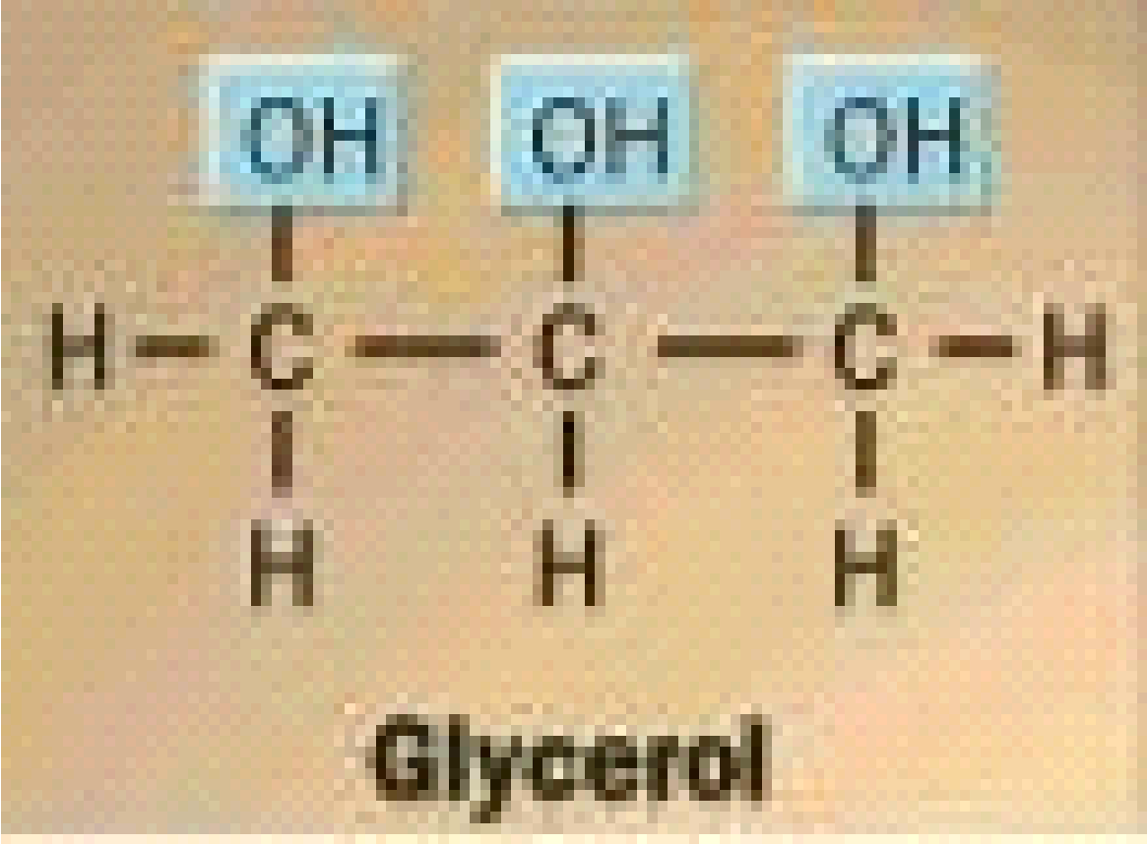
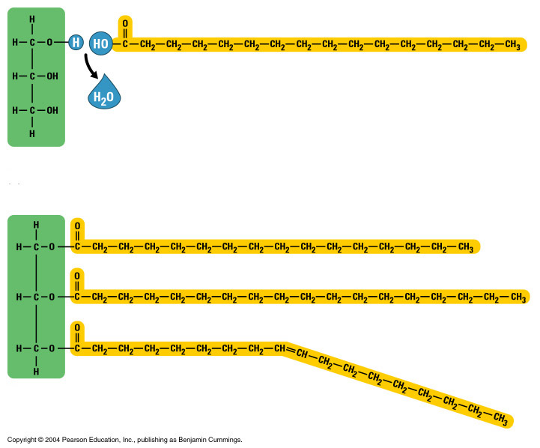
Triglyceride
Monomer of lipids
Composed of Glycerol & 3 fatty acid chains
Glycerol forms the “backbone” of the fat
Organic Alcohol (-OL ending)
Glycerol
Fatty Acid Chains
Notes:
25
25

Slide 26
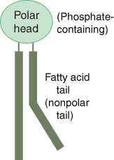
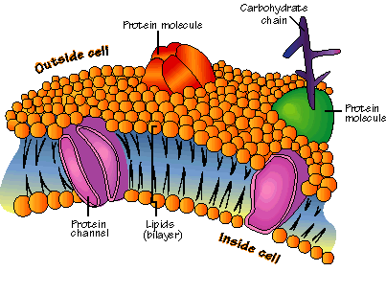
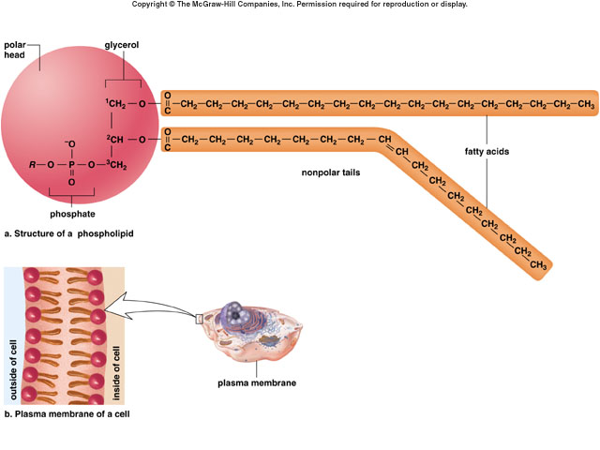
Lipids & Cell Membranes
Cell membranes are made of lipids called phospholipids
Phospholipids have a head that is polar & attract water (hydrophilic)
Phospholipids also have 2 tails that are nonpolar and do not attract water (hydrophobic)
Cell membrane with proteins & phospholipids
Notes:
26
26

Slide 27
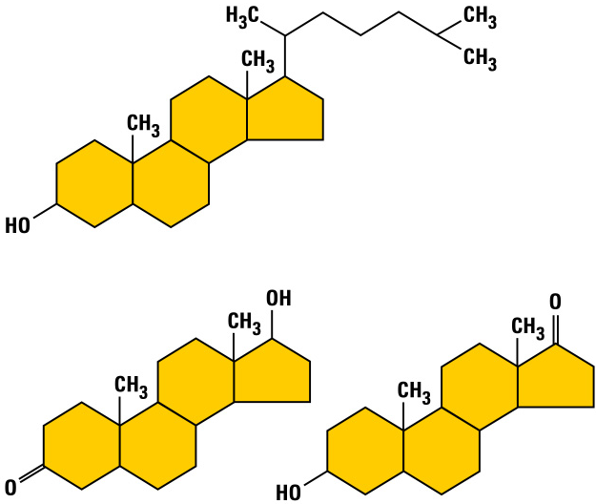
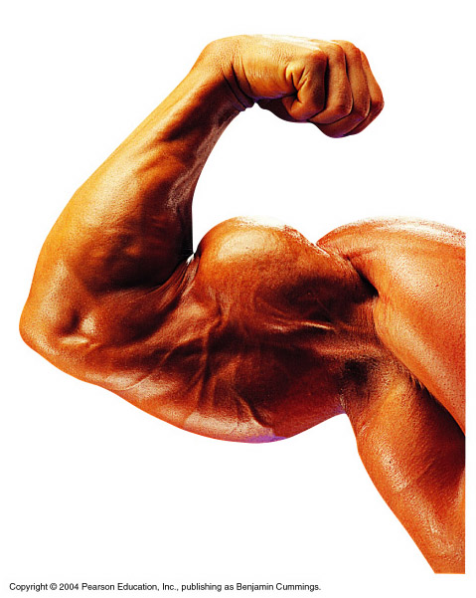
Steroids
The carbon skeleton of steroids is bent to form 4 fused rings
Cholesterol is the “base steroid” from which your body produces other steroids
Estrogen & testosterone are also steroids
Cholesterol
Estrogen
Testosterone
Synthetic Anabolic Steroids
They are variants of testosterone
Some athletes use them to build up their muscles quickly
They can pose serious health risks
Notes:
27
27

Slide 28
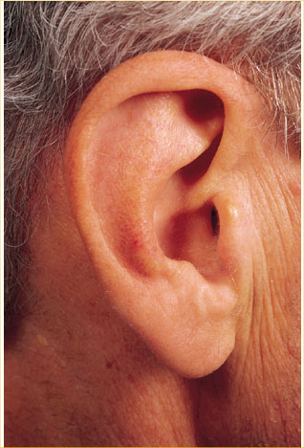
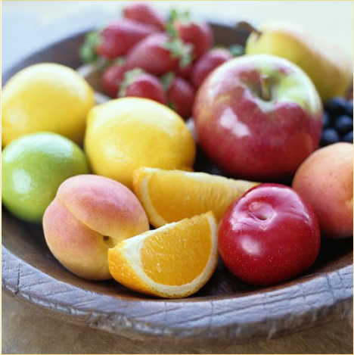
Waxes
A wax is a lipid because of its nonpolar solubility characteristics as well as its extremely hydrophobic (water-hating) properties.
Waxes are composed of a single, highly complex alcohol joined to a longchain fatty acid in a typical ester linkage.
Waxes are important structural lipids often found as protective coatings on the surfaces of leaves, stems, hair, skin, etc.
They provide effective barriers against water loss and in some situations make up the rigid architecture of complex structures such as the honeycomb of the beehive.
They serve a commercial use as well, in furniture polish, automobile coating compounds, and floor finishes.

Slide 29

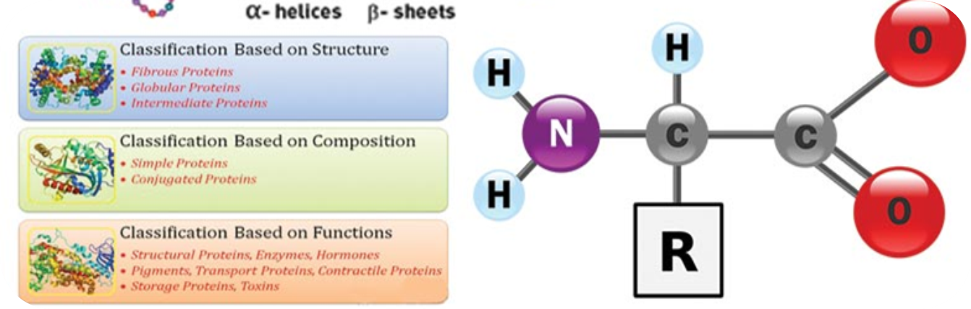
Proteins
Proteins are polymers made of monomers called amino acids
All proteins are made of 20 different amino acids linked in different orders
Proteins are used to build cells, act as hormones & enzymes, and do much of the work in a cell
Notes:
29
29

Slide 30
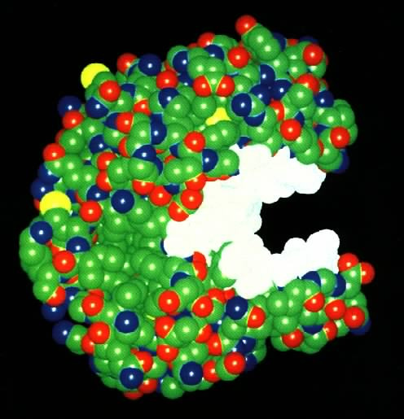
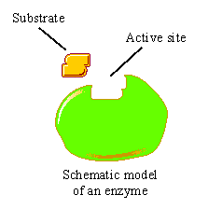
What Are Enzymes?
Most enzymes are Proteins (tertiary and quaternary structures) Act as Catalyst to accelerates a reaction Not permanently changed in the process Are specific for what they will catalyze Are Reusable Name Ends in –ase .Sucrase -Lactase -Maltase | Why Enzymes? Natural catalysts Speed: 10¹⁶ over un-catalyzed rates! Specificity: only the desired reaction occurs Permit reactions under mild conditions
30
Notes:
30

Slide 31
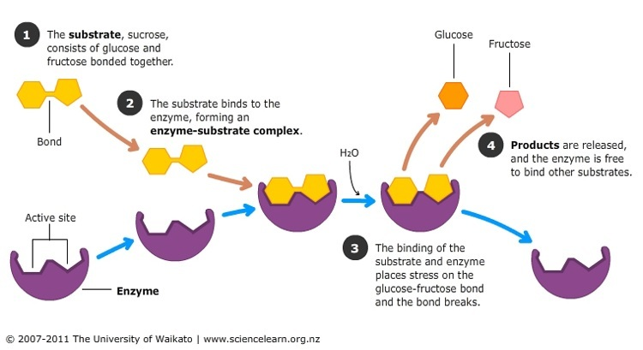
Since most reactions in your body’s cells need special enzymes, each cell contains thousands of different enzymes.
Enzymes let chemical reactions in the body happen millions of times faster than without the enzyme. Because enzymes are not part of the product, they can be reused again and again.

Slide 32
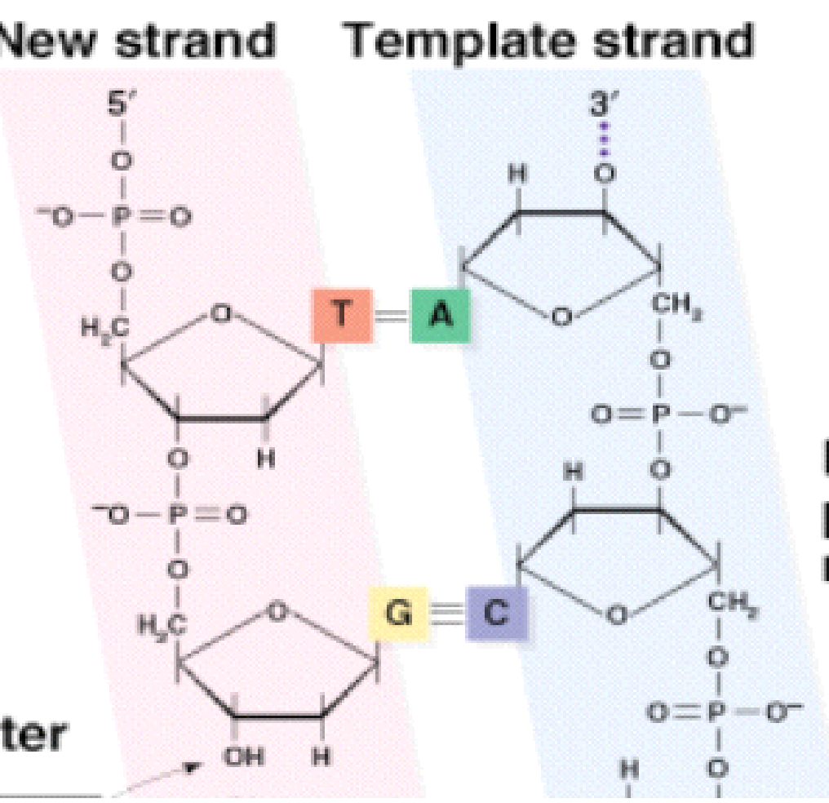
Example: Restriction enzymes
Recognizes specific base sequences in double-helical DNA and cleave, at specific places, both strands of a duplex containing the recognized sequences.
Restriction enzymes recognize specific bases pair sequences in DNA called restriction sites and cleave the DNA by hydrolyzing the phosphodiester bond.
Cut occurs between the 3’ carbon of the first nucleotide and the phosphate of the next nucleotide.
Restriction fragment ends have 5’ phosphates & 3’ hydroxyls.
Restriction
enzyme

Slide 33
Most restriction enzymes occur naturally in bacteria.
Protect bacteria against viruses by cutting up viral DNA.
Bacteria protects their DNA by modifying possible restriction sites (methylation).
More than 400 restriction enzymes have been isolated.
Names typically begin with 3 italicized letters.
Enzyme Source
EcoRI E. coli RY13
HindIII Haemophilus influenzae Rd
BamHI Bacillus amyloliquefaciens H
Many restriction sites are palindromes of 4-, 6-, or 8-base pairs.
Short restriction site sequences occur more frequently in the genome than longer restriction site sequences, e.g., (1/4)n.
Notes:
EcoRI
E: Genus
Co: species
R: Strain
I: Enzyme number

Slide 34
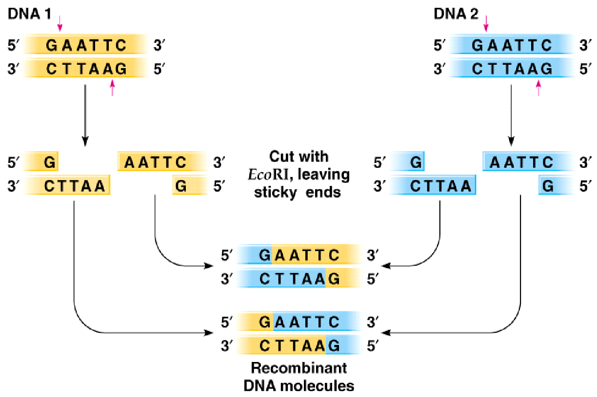
Cut and ligate 2 DNAs with EcoRI ---> recombinant DNA

Slide 35
Applications of Recombinant DNA technologies
Pharmaceutical products
• insulin – cheaper and safer compared to animal insulin
• vaccine sub-unit (against hepatitis B) – safer since will not be infected by pathogens
• DNA of vaccines against malaria, influenza etc.
Gene therapy
• replacing defective or missing gene with normal gene using adeno~ and retrovirus as vector
Gene silencing
• known as RNA interference (RNAi) using dsRNA called short interfering RNA (siRNA) that target specific gene (mRNA) and degrade it
Notes:
A. Construction of genetic “libraries” to assist in isolation / characterization of specific genes and gene products:
cDNA libraries / expression libraries genomic DNA libraries
cosmids
YAC’s (yeast artificial chromosomes)
Human Genome Project (and others…..)
B. Production of scarce proteins using expression vectors
C. Production of vaccines, hormones, blood clotting factors, etc.
D. Diagnostics: antibody and oligonucleotide probes:
cancer cells, detection / imaging
bacterial and viral diseases (Legionnaires, AIDS)
Prenatal diagnoses
Forensics
E. Therapeutics
Human insulin, Human growth hormone, interferons, growth factors, blood clotting factors, Plasminogen activator, tumor necrosis factor, novel recombinant antibodies, synthetic peptides as recombinant vaccines (Hep B, malaria, rabies, AIDS)
F. Gene Transfer
Plants---increased yield, improved tolerance, herbicide res., disease res.
Transgenic animals---production of scarce proteins (eg in cow’s milk), studies of eukaryotic gene regulation
Human gene therapy

Slide 36
Hormones
• Cells in multi-cellular organisms communicate with one another to coordinate their growth and metabolism;
• Cell to cell communicate is mainly via Extracellular signaling molecules or Hormones;
• Hormones carry information from Sensor Cells, that sense changes in the environment, to Target Cells that respond to the changes;
• Hormones tend to coordinate various metabolic processes in the body;

Slide 37
Examples
INSULIN:
• Insulin is a Protein Hormone secreted by Beta cells in Islets of Langerhans in Pancreas,
• Insulin is a major hormone that regulates Blood Glucose level,
• Insulin is an Hydrophilic (Lipophobic) hormone, thus it acts via membrane receptors on target cells; • Main target cells: Skeletal Muscle & Adipose tissue
Lack of insulin causes increase in blood sugar level called diabetes

Slide 38
GLUCAGON:
• Glucagon is a hormone produced by Alpha cells in the Pancreas;
• Glucagon is an Insulin Counter-Regulatory Hormone,
• Action of Glucagon is to increase Blood Glucose Level from Low to Normal,
• Glucagon acts mainly in the Liver to stimulate the breakdown of Glycogen to Glucose, which is then released into the blood;
Production of Glucagon is stimulated by:
• Hypoglycemia (Low Glucose level in blood) • Increase absorption of Amino Acids in the blood (as occurs after a protein-rich meal),
• High Blood Glucose Level Inhibits the production and release of Glucagon,

Slide 39
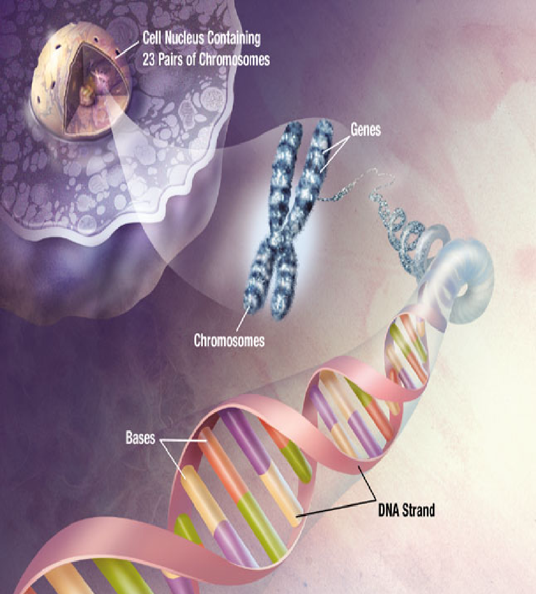
Nucleic Acids
Store hereditary information
Contain information for making all the body’s proteins
Two types exist --- DNA & RNA
Notes:
39
39

Slide 40
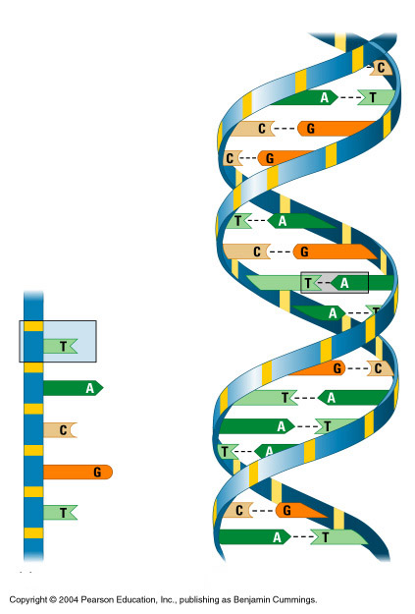
DNA-Deoxyribonucleic acid
Backbone
Two strands of DNA join together to form a double helix
Nucleotides form long chains called DNA
Nucleotides are joined by sugars & phosphates on the side
Nucleotide
Base
pair
Bases
DNA strand
Double helix
Notes:
40
40

Slide 41
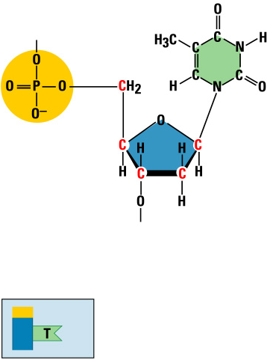
Nucleic Acids
Nitrogenous base
(A,G,C, or T)
Nucleic acids are polymers of nucleotides
Phosphate
group
Thymine (T)
Sugar
(deoxyribose)
Phosphate
Base
Sugar
Nucleotide
Notes:
41
41

Slide 42
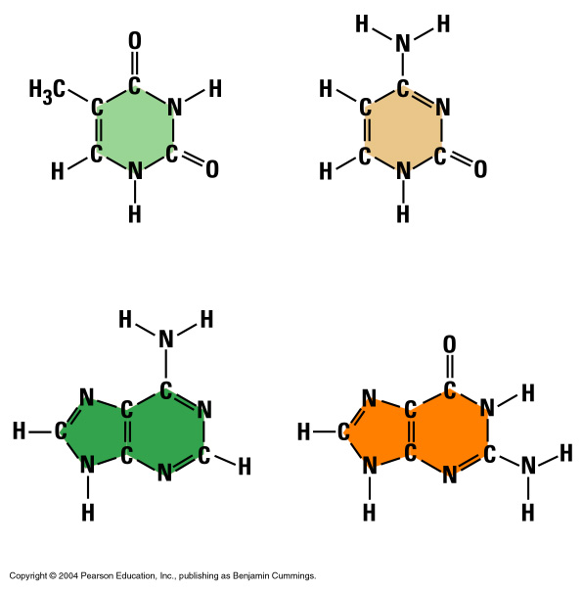

Bases
Each DNA nucleotide has one of the following bases:
Thymine (T)
Cytosine (C)
Adenine (A)
Guanine (G)
Thymine (T)
Cytosine (C)
Adenine (A)
Guanine (G)
Notes:
42
42

Slide 43
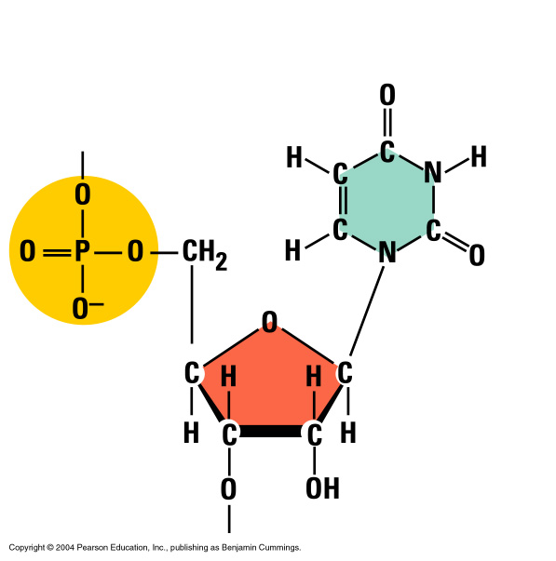
RNA – Ribonucleic Acid
Ribose sugar has an extra –OH or hydroxyl group
It has the base uracil (U) instead of thymine (T)
Nitrogenous base
(A,G,C, or U)
Uracil
Phosphate
group
Sugar (ribose)
Notes:
43
43

Slide 44
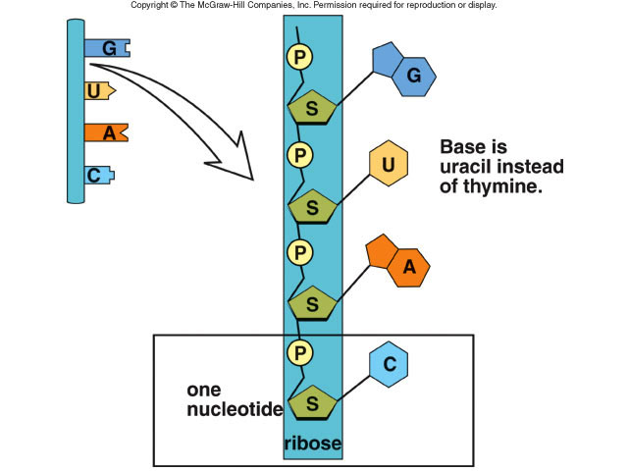
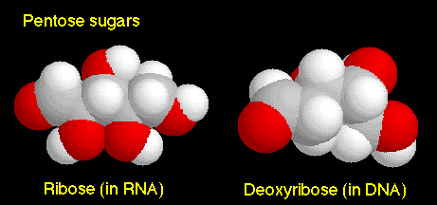
RNA Differs from DNA
1. RNA has a sugar ribose
DNA has a sugar deoxyribose
2. RNA contains the base uracil (U)
DNA has thymine (T)
3. RNA molecule is single-stranded
DNA is double-stranded
Notes:
44
44

Slide 45
Three Types of RNA
.
Messenger RNA (mRNA) carries genetic information to the ribosomes
(blueprint for the construction of a protein)
Ribosomal RNA (rRNA), along with protein, makes up the ribosomes
(construction site where the protein is made)
Transfer RNA (tRNA) transfers amino acids to the ribosomes where proteins are synthesized
(truck delivering the proper amino acid to the site at the right time)
Notes:
45
. Ribosomal RNA (rRNA) is the. Transfer RNA (tRNA) is the.
45

Slide 46
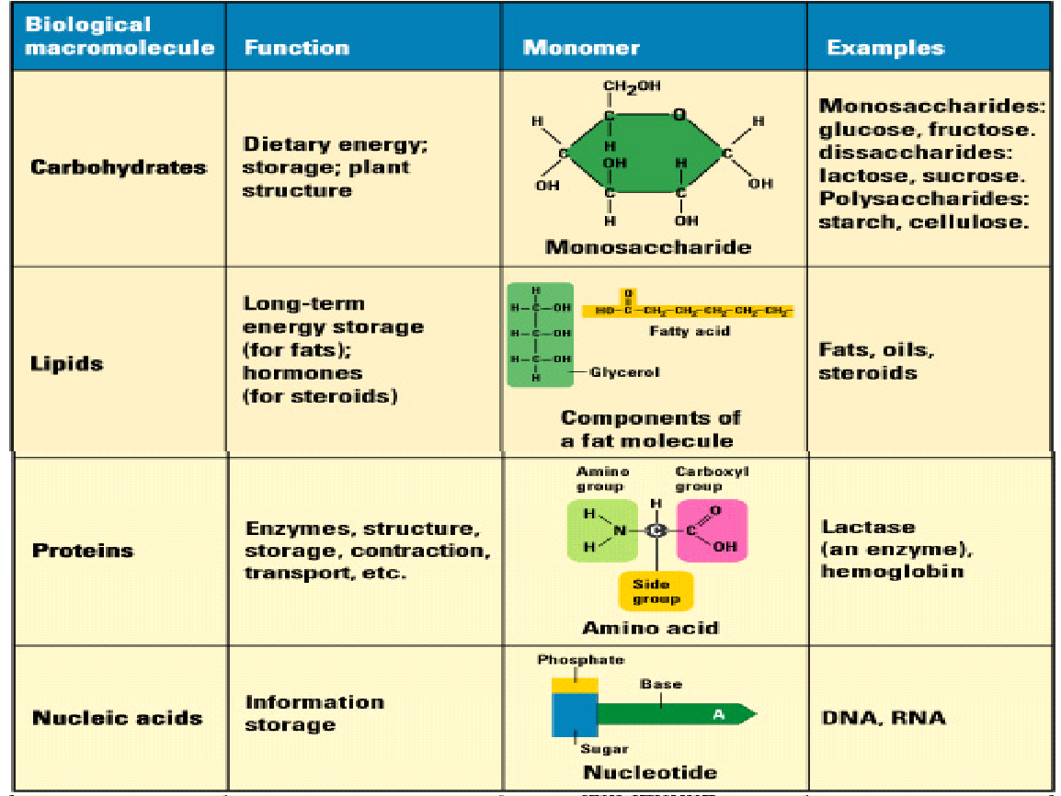
Macromolecules
Notes:
46
46

Slide 47
The human genome project
Genomics
Sequence databases
BLAST tool

Slide 48
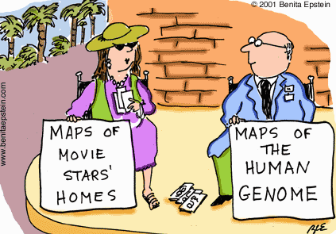
HUMAN GENOME PROJECT [HGP]
HGP aim: sequence the entire human genome and provide the data free to the world.

Slide 49
Global collaboration which was the largest biological research project ever undertaken, involving thousands of staff in institutes across the globe.
13 years of work before a rough draft of the human genome was published in 2003
It provided information of 3 trillion base pairs- and sequences of 30,000 genes.
the data is provided as free and open access to everyone in the scientific community and the public domain through freely available, online public databases.

Slide 50
APPLICATIONS
Molecular Medicine
Through genetic research, medicine will look more into the fundamental causes of diseases rather than concentrating on treating symptoms.
Genetic screening will enable rapid and specific diagnostic tests making it possible to treat countless maladies.
DNA-based tests clarify diagnosis quickly and enable geneticists to detect carriers within families.
Genomic information can indicate the future likelihood of some diseases.
Waste Control and Environmental Cleanup
microbes that live under extreme temperature and pressure conditions have been sequenced. By learning the unique protein structure of these microbes, researchers may be able to use the organisms and their enzymes for such practical purposes as waste control and environmental cleanup .
Energy Sources
Having the genomic sequence of the methane-producing microorganism will allow researchers to explore the process of methanogenesis in more detail and could lead to cheaper production of fuel-grade methane .
Risk Assessment
ability to assess risks posed to individuals by environmental exposure to toxic agents. Scientists know that genetic differences cause some people to be more susceptible than others to such agents. to understand the effects of low-level exposures to radiation and other energy-related agents, especially in terms of cancer risk.

Slide 51
Genomics
Genomics is the study of whole genomes of organisms, and incorporates elements from genetics.
Types:
Structural Genomics is the initial phase of genome sequencing which give the structure of every protein coded by the genome
Functional genomics is the study of how genes and intergenic regions of the genome contribute to different biological processes.
Comparative genomics Comparison of whole genomes from different organisms

Slide 52
Main points related to genomics are
i. It is a computer aided study of structure and function of entire genome of an organism.
ii. It deals with mapping and sequencing of genes on the chromosomes.
iii. use of genomic techniques has become indispensible in plant breeding and genetics.

Slide 53
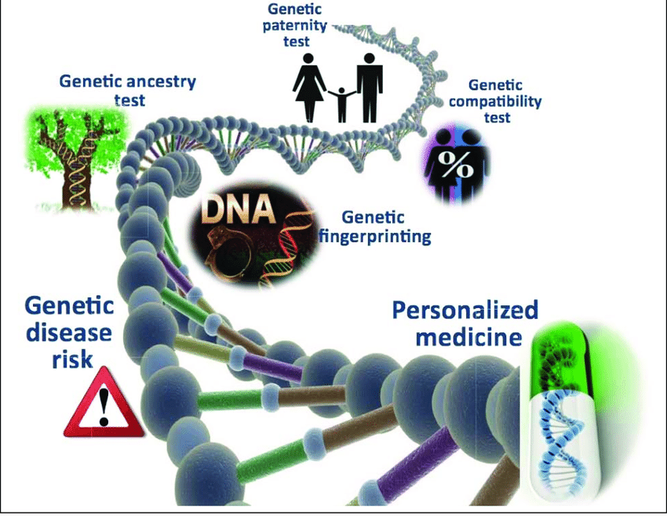

Slide 54
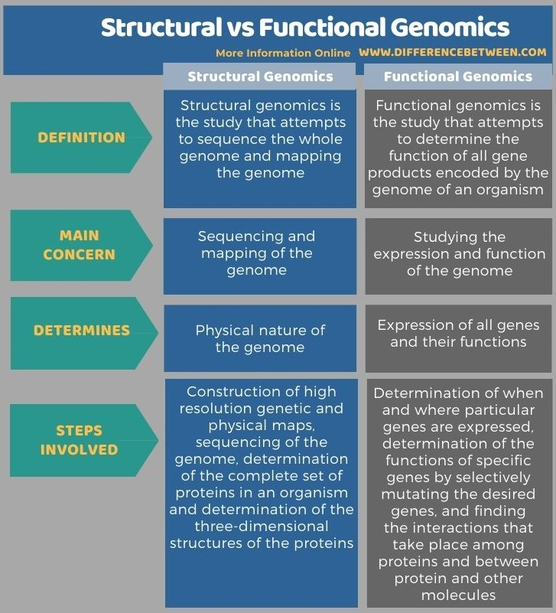

Slide 55
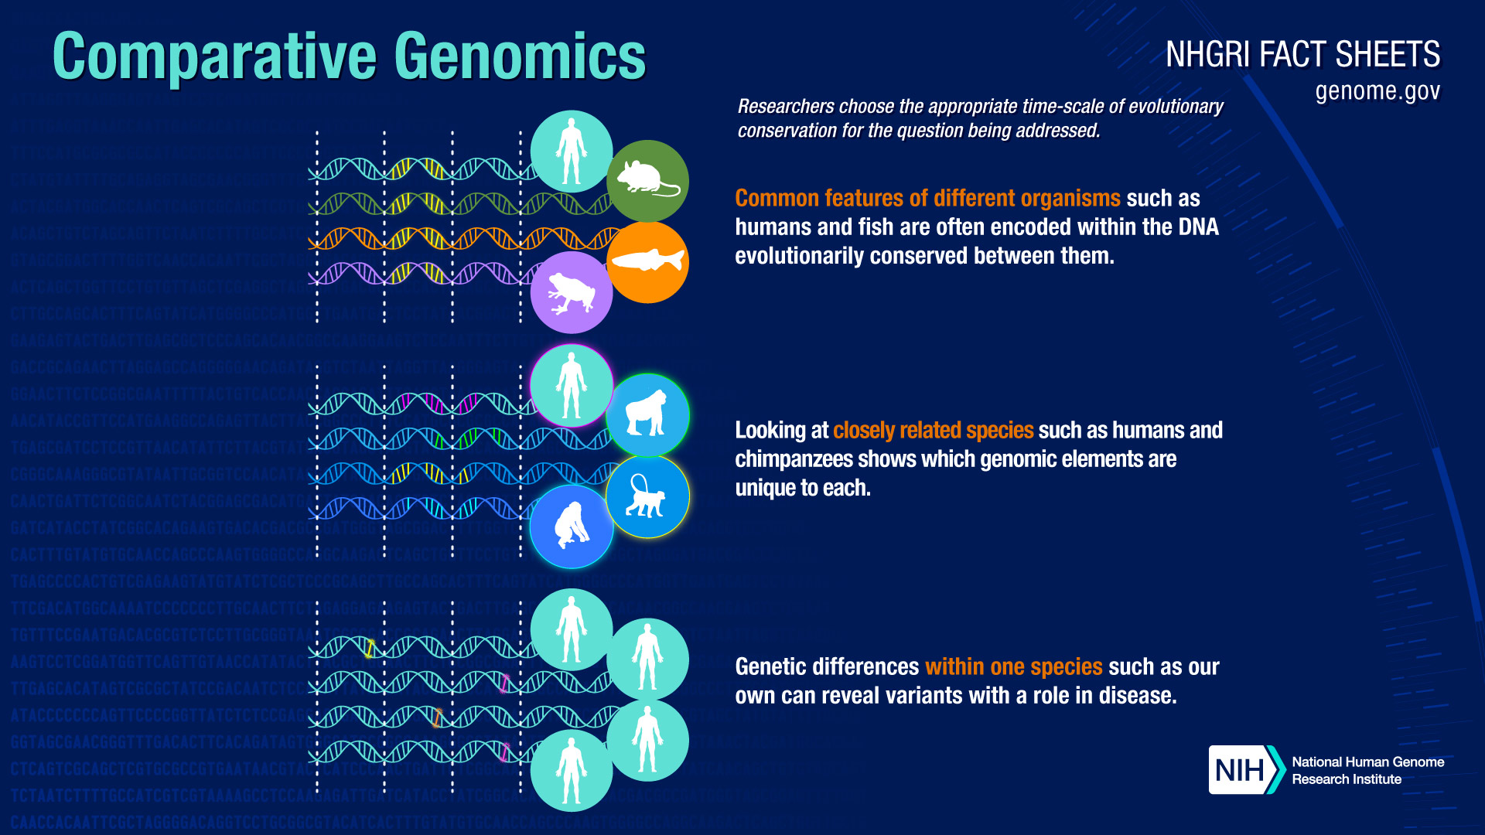

Slide 56
Genome databases/ Biological Databases
One of the hallmarks of modern genomic research is the generation of enormous amounts of raw sequence data.
As the volume of genomic data grows, sophisticated computational methodologies are required to manage the data deluge.
Thus, the very first challenge in the genomics era is to store and handle the staggering volume of information through the establishment and use of computer databases.
A biological database is a large, organized body of persistent data, usually associated with computerized software designed to update, query, and retrieve components of the data stored within the system.
The chief objective of the development of a database is to organize data in a set of structured records to enable easy retrieval of information.
Uses of biological Databases :
It helps the researchers to study the available data and use in their research hypothesis
It helps scientists to understand the concepts of biological phenomena.
The database acts as a storage of information.
It helps remove the redundancy of data.

Slide 57
Database types
1. Primary databases :
It can also be called an archival database since it archives the experimental results submitted by the scientists. The primary database is populated with experimentally derived data like genome sequence, The data entered here remains un curated
It obtains unique data obtained from the laboratory and these data are made accessible to normal users without any change.
Examples of Primary database-
Nucleic Acid Database
GenBank -
https://www.ncbi.nlm.nih.gov/nucleotide/
Protein Databases are
PDB- Protein structure database https://www.rcsb.org/
UniprotKB- Protein sequence database Database https://www.uniprot.org/uniprotkb?query=*

Slide 58
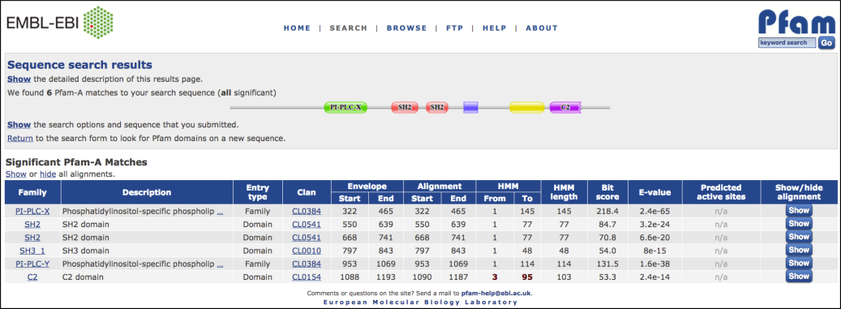
Secondary databases
Secondary databases comprise data derived from the results of analyzing primary data.
Secondary databases often draw upon information from numerous sources, including other databases (primary and secondary), controlled vocabularies and the scientific literature.
They are highly curated, often using a complex combination of computational algorithms and manual analysis and interpretation to derive new knowledge from the public record of science.
Examples
InterPro (protein families, motifs and domains)-https://www.ebi.ac.uk/interpro/
Pfam
Prosite

Slide 59
Searching and querying the databases
Database searching for similar sequences is ubiquitous in bioinformatics.
Databases are large and getting larger
Need fast methods
Search Tools types
Similarity Search Tools – Smith-Waterman Searching
Heuristic Search Tools – FASTA – BLAST

Slide 60
BLAST
BLAST stands for Basic Local Alignment Search Tool.
It is a local alignment algorithm-based tool that is used for aligning multiple sequences and to find similarity or dissimilarity among various species.
BLAST is a heuristic method which means that it is a dynamic programming algorithm that is faster, efficient but relatively less sensitive.
Finds regions of similarity between sequences.
The program compares nucleotide or protein sequences and calculates the statistical significance of matches.

Slide 61
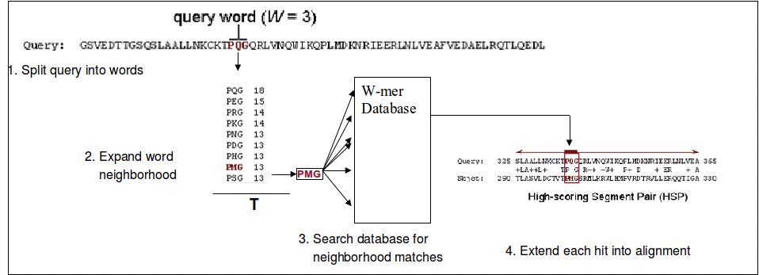
BLAST Algorithm
The steps are as follows:
Split query into overlapping words of length W (the W-mers)
Find a “neighborhood” of similar words for each word
Lookup each word in the neighborhood in a hash table to find the location in the database where each word occurs.
Call these the seeds, and let S be the collection of seeds.
Extend the seeds in S until the score of the alignment drops off below some threshold X.
Report matches with overall highest scores

Slide 62
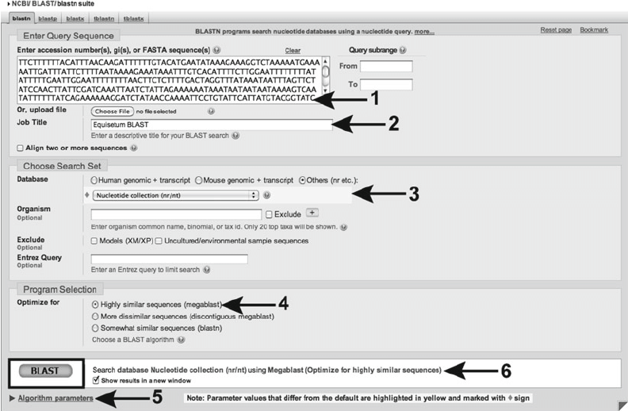
(1) Enter the query sequence; (2) Select a job title; (3) Select the database to search; (4) Select the BLAST algorithm to use; (5) Adjust the algorithm as necessary; (6) Start the BLAST.

Slide 63
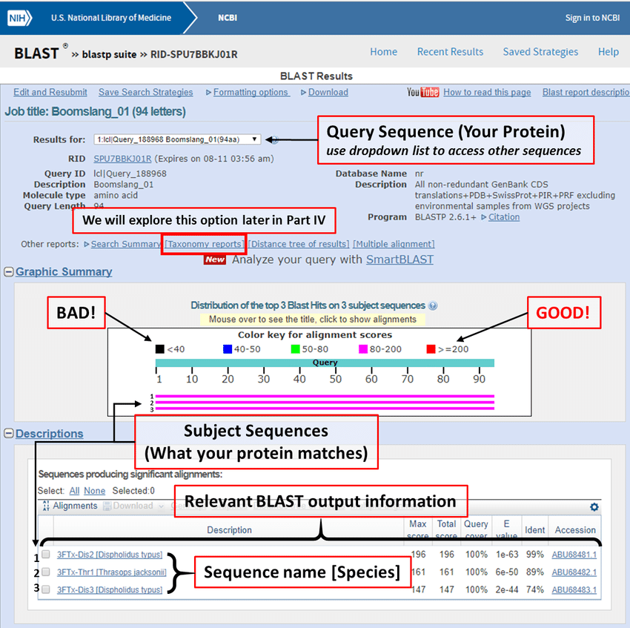

Slide 64
Blast returns the output in the form of hit tables that are arranged in decreasing order of matched accession number along with their titles, query coverage, sequence identity, score, and an e-value in separate columns. The reliability of the matched sequences is assessed by e-value.
E value-The Expectation value or Expect value represents the number of different alignments with scores equivalent to or better than S that is expected to occur in a database search by chance. The lower the E value, the more significant the score and the alignment.

Slide 65
BLAST Program Types | Further details
nucleotide blast or blastn | Compares a nucleotide query sequence against a nucleotide sequence database.
protein blast or blastp | Compares an amino acid query sequence against a protein sequence database.
blastx | Compares a nucleotide query sequence translated in all reading frames against a protein sequence database. You could use this option to find potential translation products of an unknown nucleotide sequence.
tblastn | Compares a protein query sequence against a nucleotide sequence database dynamically translated in all reading frames.
tblastx | Compares the six-frame translations of a nucleotide query sequence against the six-frame translations of a nucleotide sequence database. Please note that the tblastx program cannot be used with the nr database on the BLAST Web page because it is computationally intensive
Notes:
Learn tutorial for blast @ https://www.youtube.com/watch?v=HXEpBnUbAMo
65

Slide 66
THANK YOU
Notes:
Le
66

